Slide 1
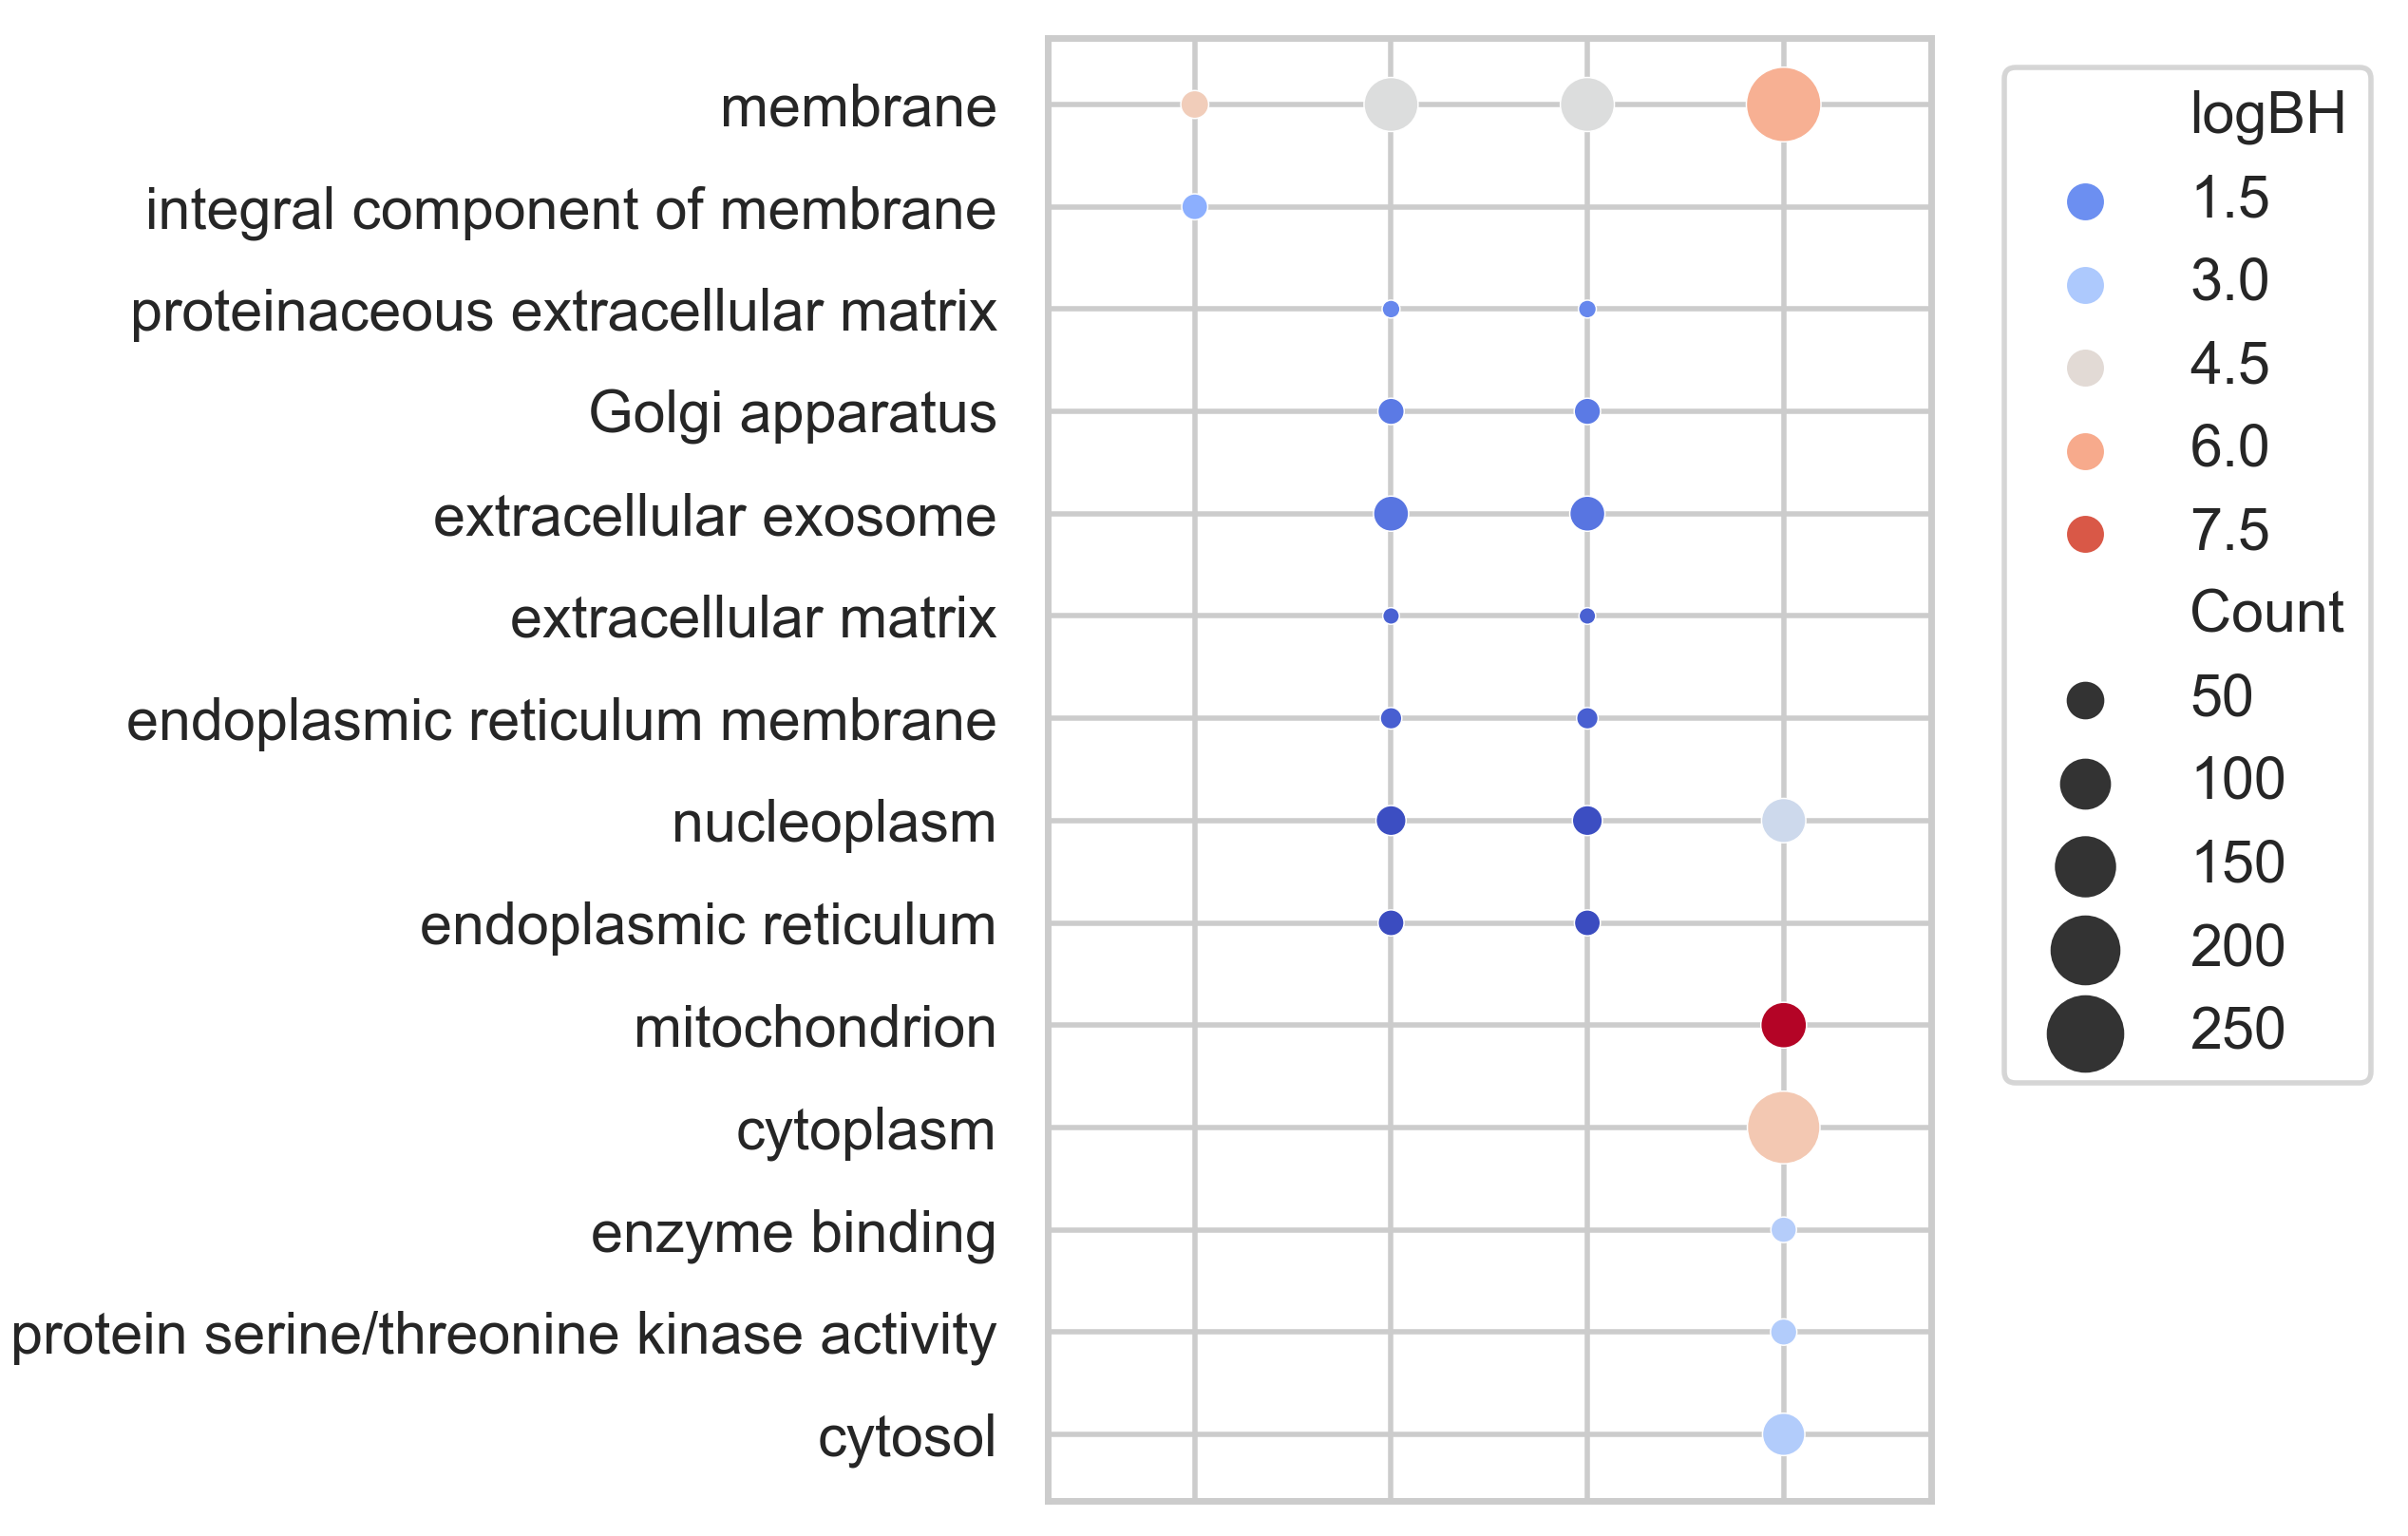
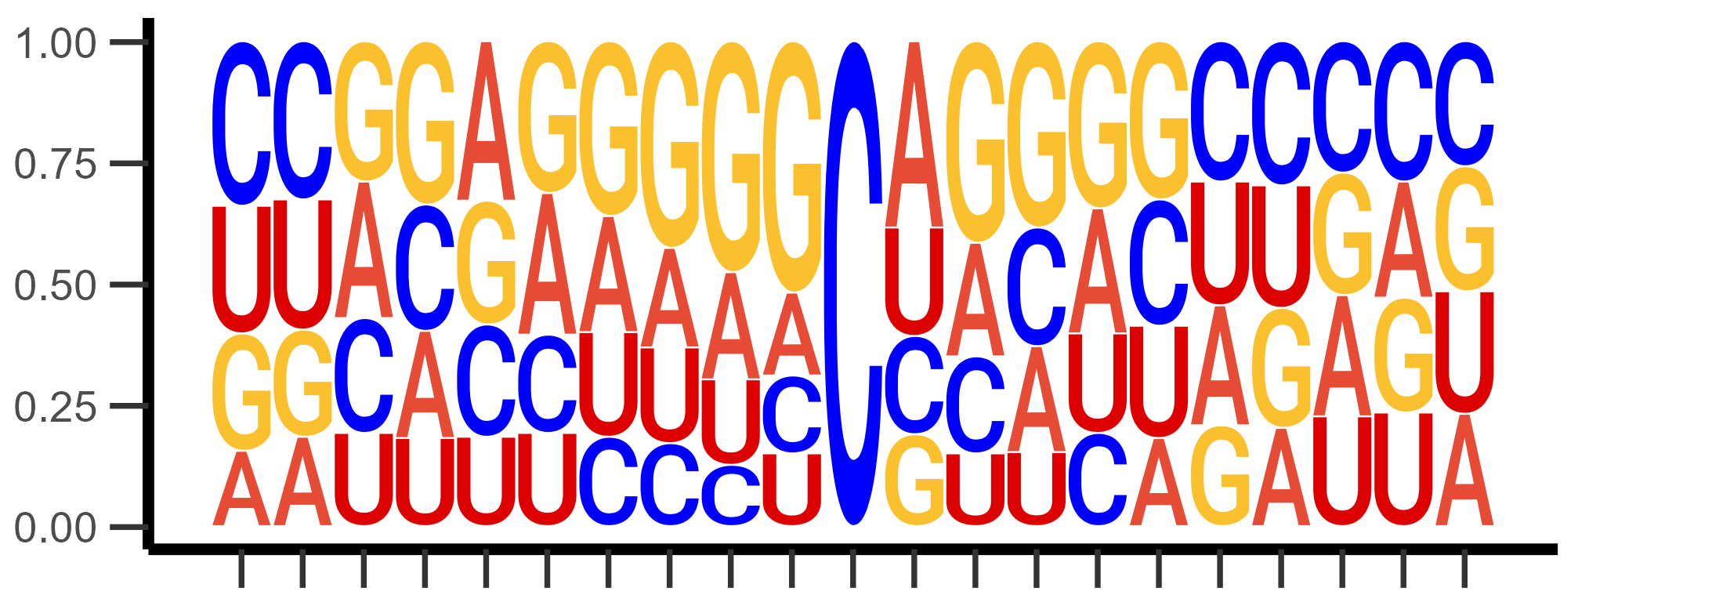
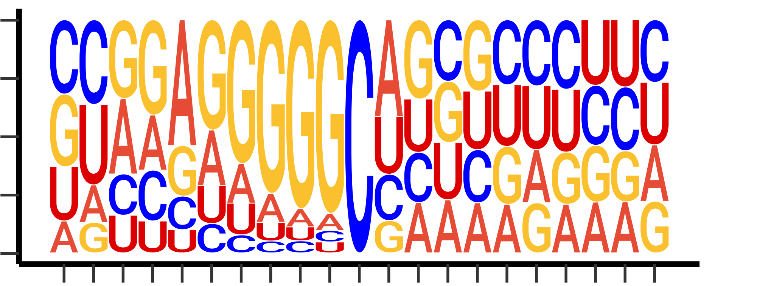
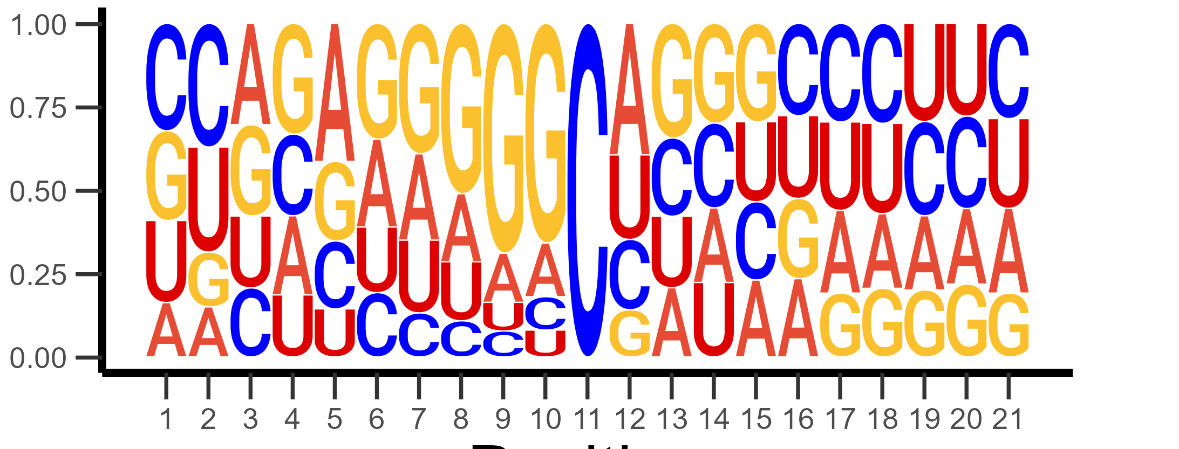
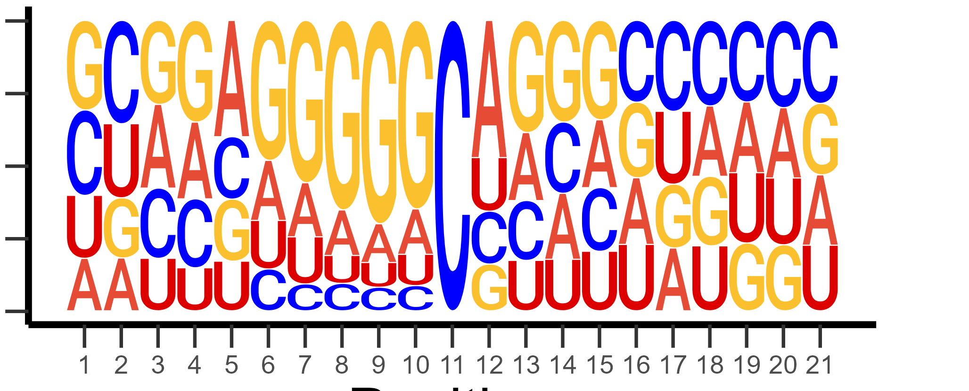
A
MT libraries
Huang
Total RNA
Polysome RNA
B
Mitochondrial RNA
Total RNA
Probability
Polysomal RNA
Huang
Position
Notes:
(C) Sequence context of all passing p-m5C sites without the use of an m-bias filter.

